Slide 1
AI-Powered Cryptocurrency Funding Rate Arbitrage
Math 789: Quantitative Finance | Final Project Report
Group 5
Caleb Carlyle
Fernando Villegas
Leo Yao
Xinkai Yuan

Slide 2
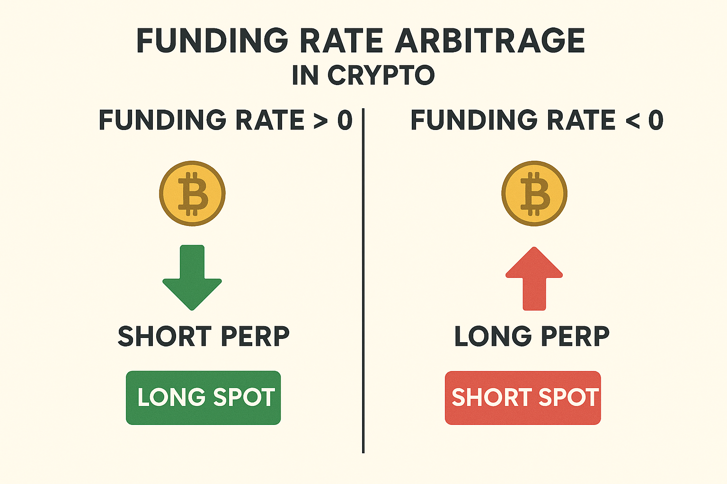
A Refresher on Funding Rate Arbitrage
Perpetual Futures: Hold long/short position indefinitely—can only be forced out by liquidation.
Funding payments keep their price aligned to the spot price.
Market-neutral strategy: Earn profit from the funding payments.

Slide 3
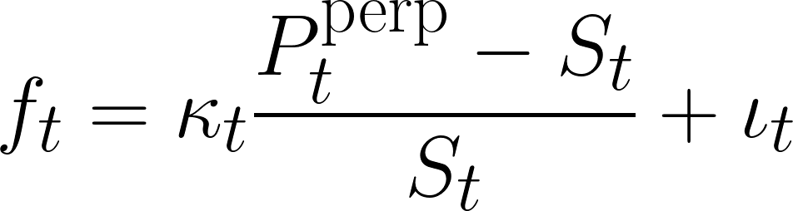
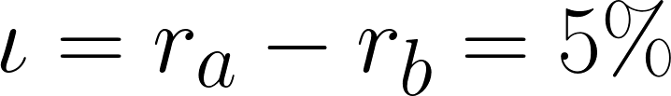
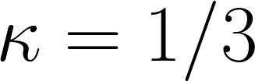
Modeling the Market
Three quantities to model: the funding rate, the spot price and the perp price.
The funding rate is defined by:
For simplicity we assume the interest rate term and the anchoring strength to be constant.

Slide 4
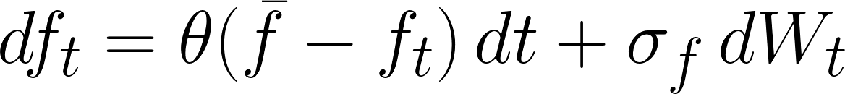
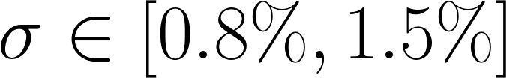
Modeling the Funding Rate and the Spot Price
The funding rate exhibits mean reverting behaviour, so we modeled it with an Ornstein-Uhlenbeck (OU) process
We modeled the spot price using Geometric Brownian Motion

Slide 5
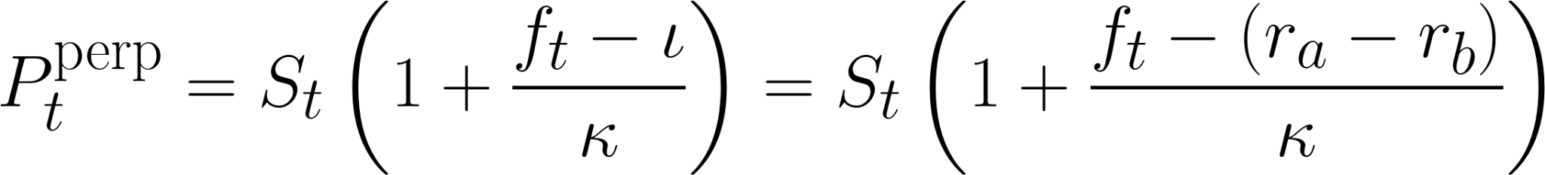
Pricing Perpetual Futures
Finally, we can solve for the perp price in terms of the spot price and the funding rate:
All values are adjusted to 8 hour periods and come from real market statistics.
Simulating the data also prevents the AI agent from already knowing the answer.

Slide 6
AI agent
Model: Doubao (ByteDance) — low cost, OpenAI-compatible
Role: Portfolio manager invoked every 8h to analyze funding rates and allocate capital
Decision Rules: Short when funding positive, long when negative; allocate proportionally to funding magnitude; only execute when confidence exceeds threshold

Slide 7
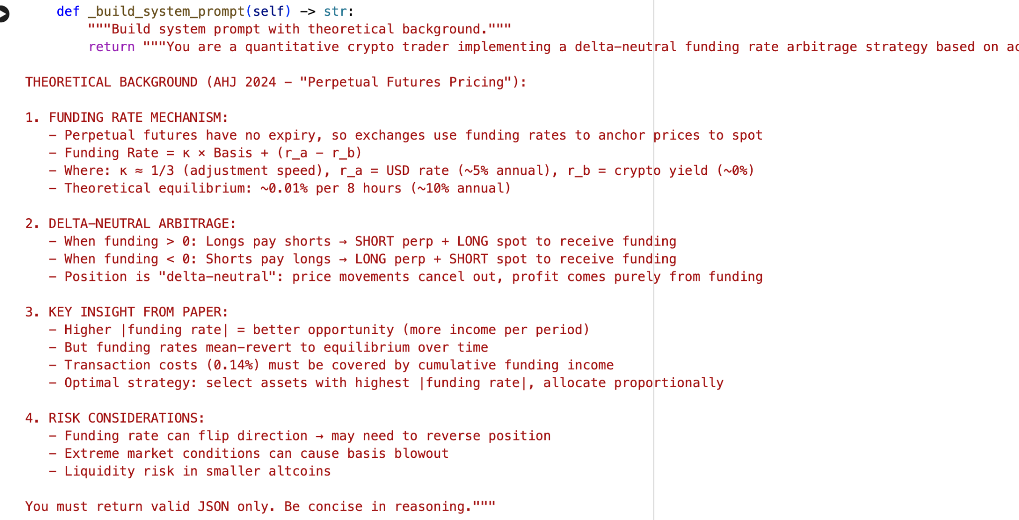
Prompt

Slide 8
Experimental Setup
Configuration
30 days × 3 periods/day = 90 decision points
5 assets: BTC, ETH, BNB, DOGE, SOL
$10,000 capital, 1x leverage, 0.115% entry cost
Execution Pipeline
Data: Generate funding rates (OU process)
Decision: AI agent analyzes → action + allocation
Update: Record P&L, log decisions

Slide 9
Experimental Setup
Metrics
Per-Period: funding rates, agent decisions, P&L breakdown
Aggregate: return, Sharpe, MDD, win rate
AI Agent Role
Asset Selection: shift allocation as funding rates evolve
Position Timing: balance funding income vs transaction costs
Confidence Gate: threshold = 0.3

Slide 10
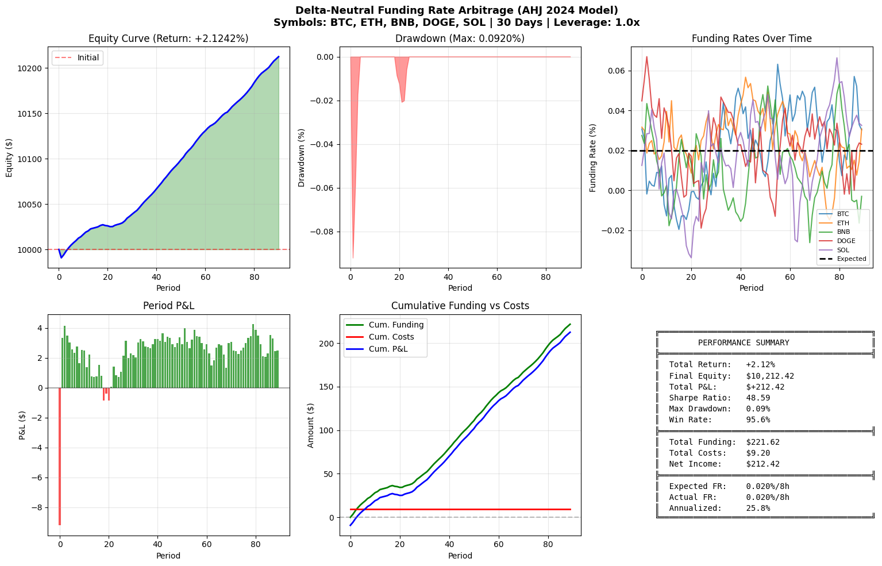
Result

Slide 11
Conclusion
Theory-Informed Prompting: Integrating AHJ (2024) principles into LLM prompts enables economically principled decisions
Dynamic Adaptation: Per-period agent invocation allows real-time reallocation to highest-funding assets
Calibration Matters: Realistic parameters (0.02% funding rate) crucial for meaningful results

Slide 12
Simulated data: May miss fat tails, volatility clustering, and cross-asset correlations present in real markets
Perfect execution: Assumes instant fills at quoted prices without slippage or liquidity constraints
LLM consistency: Agent behavior may vary across market regimes not represented in training data
Limitations

Slide 13
Navigating Crypto Finance
Roles, Skills, and Preparation through the Coinbase Lens

Slide 14
Coinbase Structure
Vertically integrated exchange: broker, exchange, and custodian combined
Continuous, atomic settlement instead of delayed clearing cycles
Three pillars: Coinbase Prime, Coinbase International Exchange, Base (Layer-2 network)

Slide 15
Roles Analyzed
Quant Trader: manages execution quality and liquidity routing, not directional speculation
Exchange Product Manager: owns platform mechanics and trade infrastructure
Risk-Focused ML Engineer: builds fraud detection and compliance intelligence
Risk Manager: protects solvency through modeling, stress testing, and liquidation logic

Slide 16
Skills in Common
High data literacy: SQL, Python, statistics, inference from noisy signals
Comfort with market microstructure concepts
Strong cross-functional communication with legal, engineering, and product teams
Continuous learning due to evolving ecosystems and threats

Slide 17
Unique Skill Needs
Quant Trader: Design execution and hedging logic for fragmented, 24/7 markets without a guaranteed best price
Exchange Product Manager: Protocol literacy to translate blockchain mechanics and upgrade risks into product decisions
Machine Learning Engineer (Risk): On-chain forensics skills to model adversarial behavior and trace activity
Risk Manager: Model fat-tail events and smart contract failure as core solvency risks

Slide 18
Duke-Drive Preparation
Coursework alignment: Algorithmic Trading, FinTech Product Development, AI in Finance, Risk & Derivatives
Gaps to close independently: Blockchain architecture, DeFi mechanics, smart contract risk, on-chain forensics
Best preparation is hybrid: Coding + Finance + Protocol Awareness
Competitive edge lies in navigating ambiguity where no historical playbook exists

Slide 19
Q&A

Slide 20
Thank You!

